Slide 1
Tech Topics:
Alternatives to
Adobe Creative Cloud

Slide 2
Overview
Adobe apps
Why do we need alternatives?
Comparison of alternatives
More resources

Slide 3
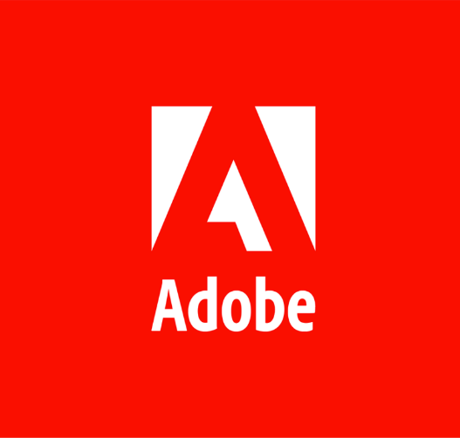
Popular Adobe Apps
Photoshop- raster graphics
Illustrator- vector graphics
Premiere Pro- video
InDesign- desktop publishing
Audition- audio

Slide 4
Why do we need alternatives?
Cost
Adobe monthly license
Proprietary vs. Open Source
Platforms: Windows, Mac, Linux

Slide 5
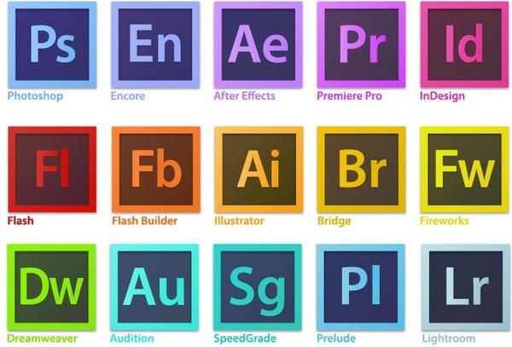
Photoshop Alternatives

Slide 6
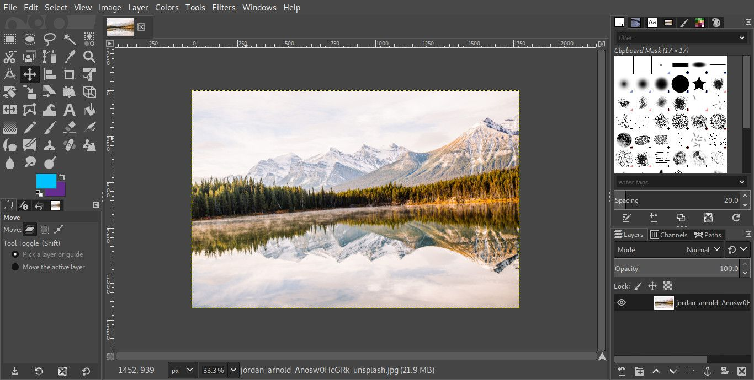
GIMP
Requires a low amount of memory to run
Can open existing .psd files
Easy to use for beginners

Slide 7
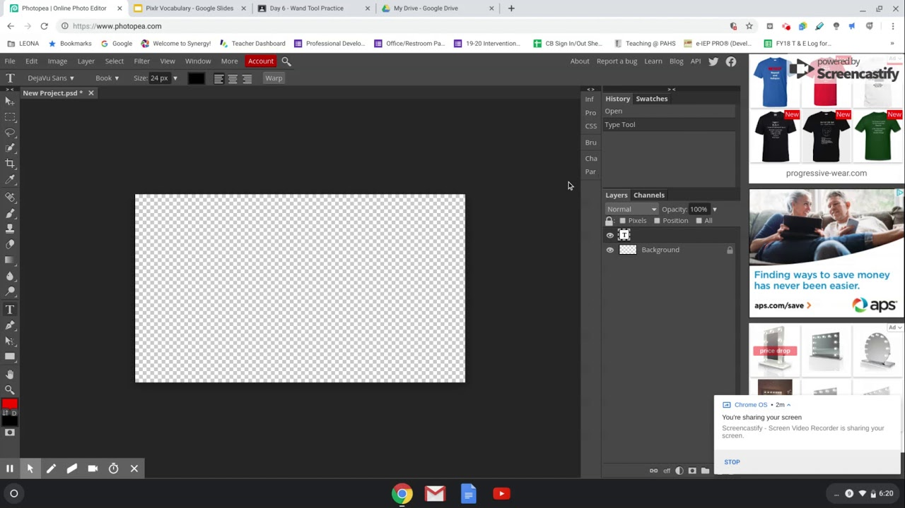
Photopea
Browser-based platform
Good for quick edits
Has lots of templates

Slide 8
Illustrator Alternatives

Slide 9
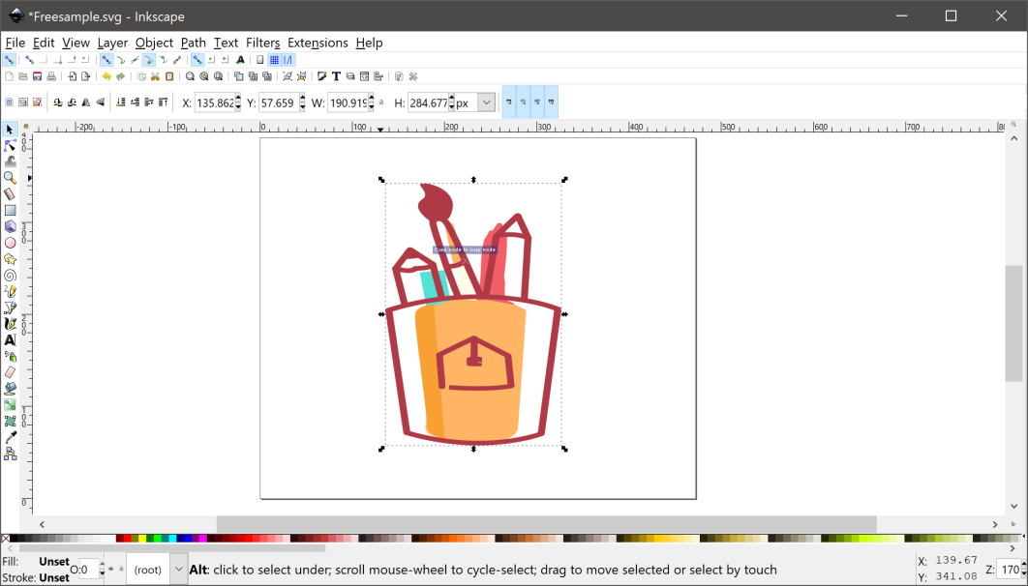
Inkscape
Simple interface
Can import .ai Illustrator files
Requires less memory

Slide 10
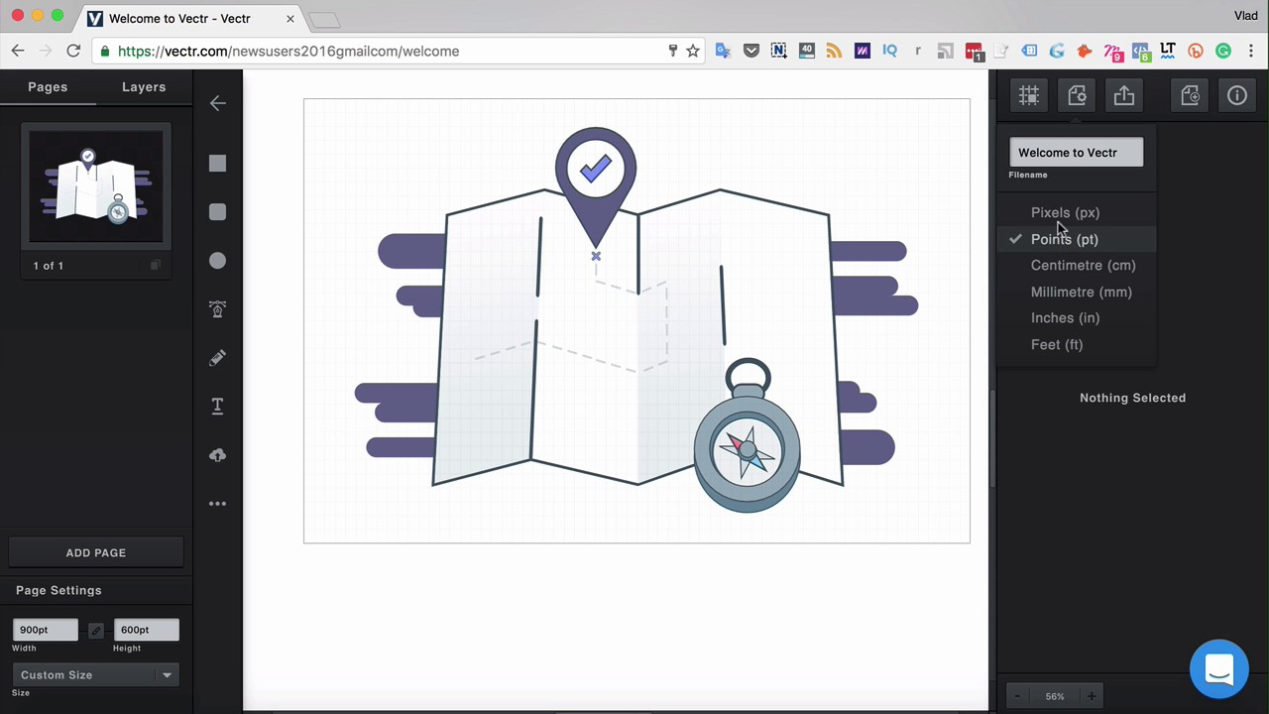
Vectr
  Browser-based platform
  List of tutorials on site
  Logos, business cards, resumes

Slide 11
Premiere Pro Alternatives

Slide 12
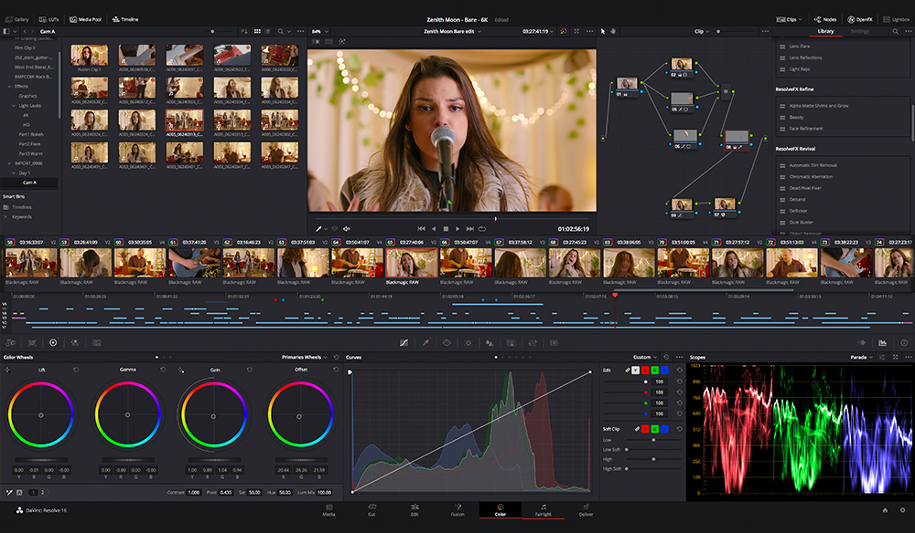
DaVinci Resolve
  Advanced color correction
  Requires more memory to run
  Studio version is $300 one time purchase

Slide 13
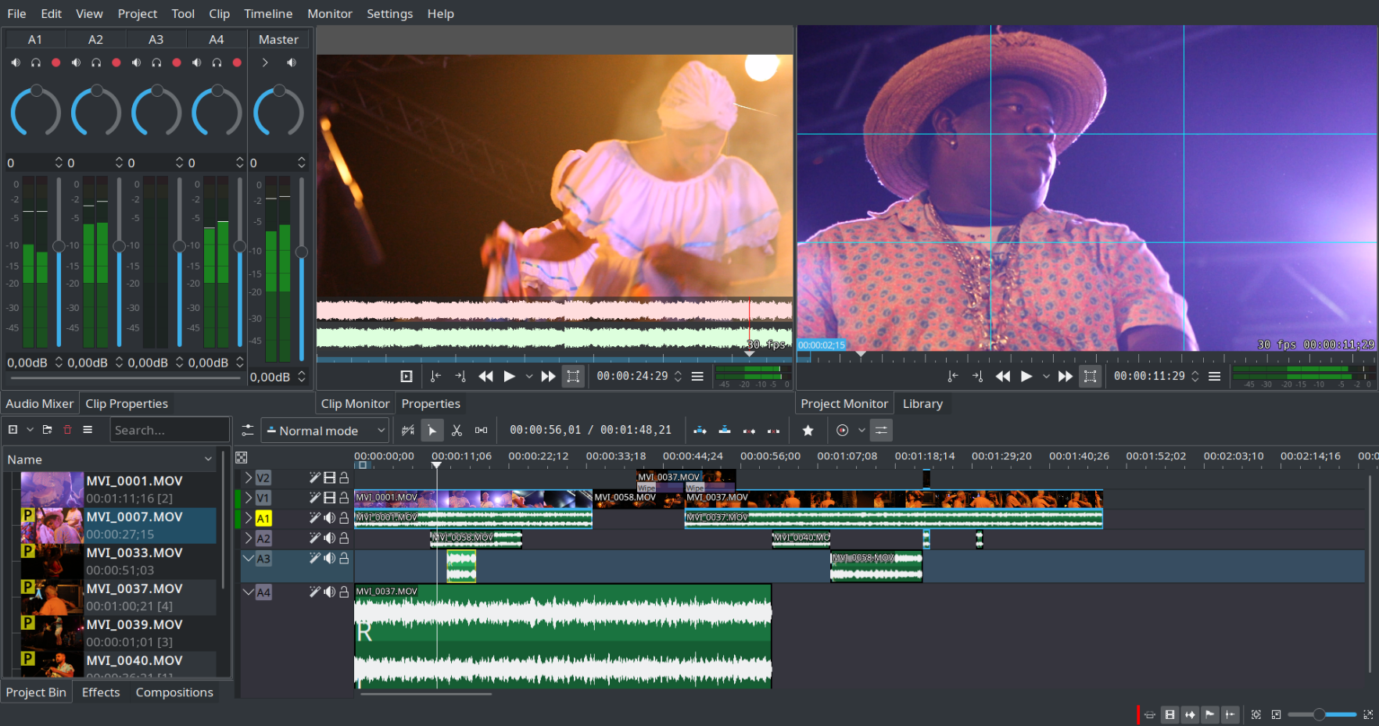
Kdenlive
Targeting for non-professional use
Customizable interface
Requires less memory

Slide 14
InDesign Alternatives

Slide 15
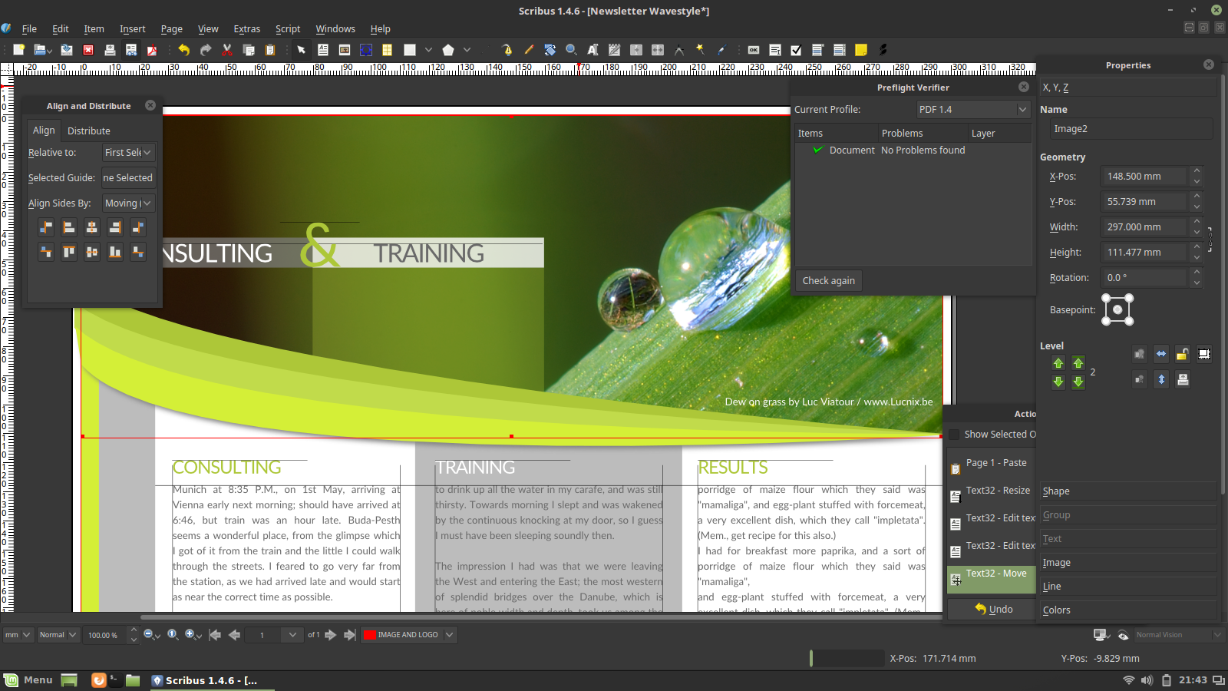
Scribus
Can import/export .svg files
Vector drawing tools
Can’t import .indd InDesign files

Slide 16
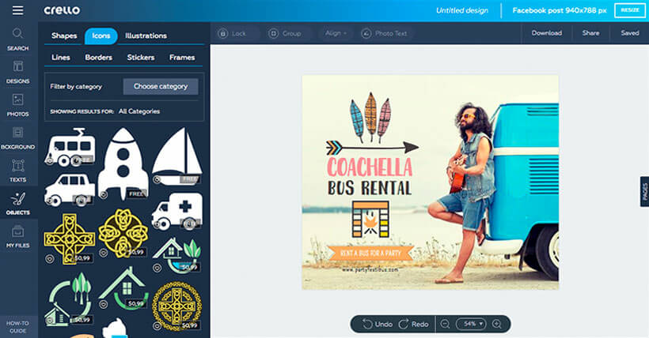
Crello
Web-based
10,000 templates
140 million stock images

Slide 17
Audition Alternatives

Slide 18
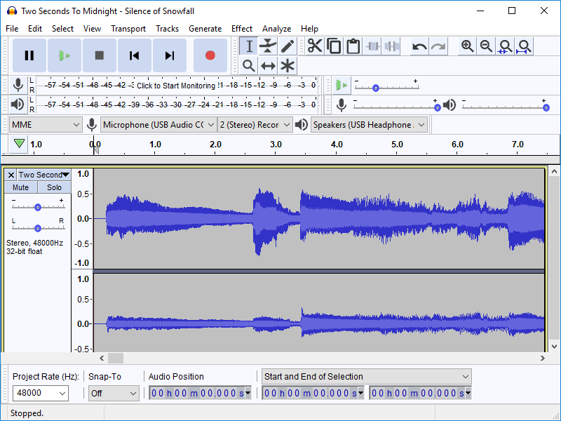
Audacity
Simple interface
Exports high quality WAV files
Destructive editing

Slide 19
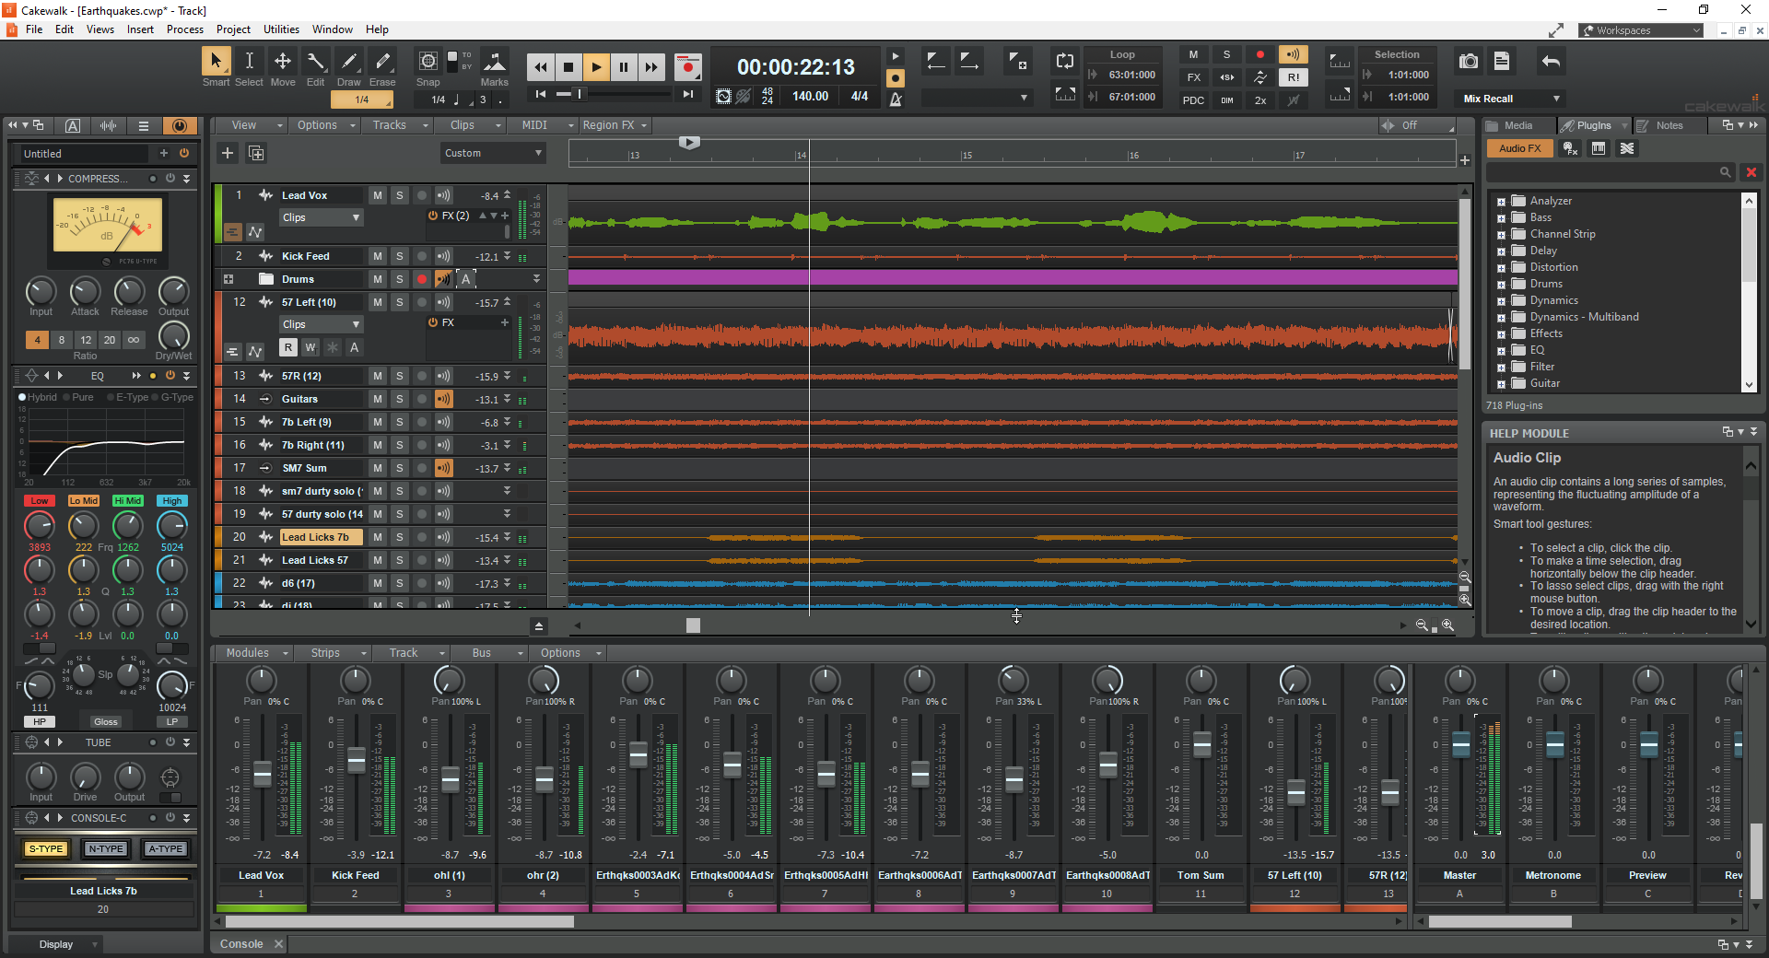
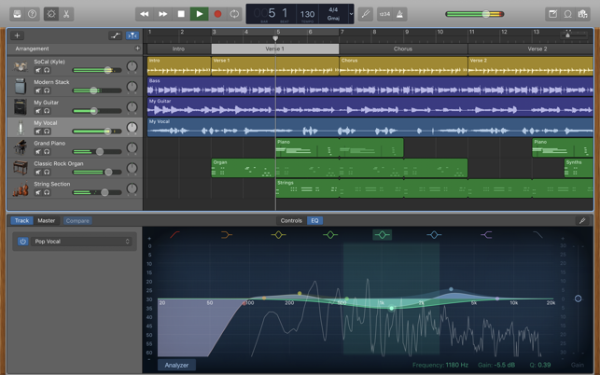
Cakewalk
Windows only
Non-destructive editing
GarageBand
Mac only
Non-destructive editing

Slide 20
Resources
Lynda.com
Email: digitalservices@balibrary.org

