Slide 1
Tech Topics:
Cutting the Cable Cord

Slide 2
Overview
Things to consider before cutting the cable cord
What equipment you need
List of hardware devices
What type of programming is available
Comparison of the popular services
Additional Resources

Slide 3
Things to consider
How to get your favorite shows and channels?
  https://thestreamable.com/matchmaker - search for specific channels
Is my internet connection strong enough to support all my devices?
Will it be cheaper than my cable bill?
Will my phone/internet bill go up if I drop cable?
Monthly subscriptions rather than yearly contracts
  Many services have free trial periods

Slide 4
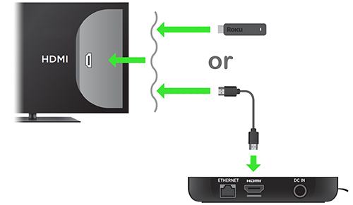

What you need to get started
Home WiFi connection
  Internet speed of 15 mbps per device
Smart TV or Hardware Streaming Device (Roku)
  May need an HDMI cable to connect streaming device to TV

Slide 5
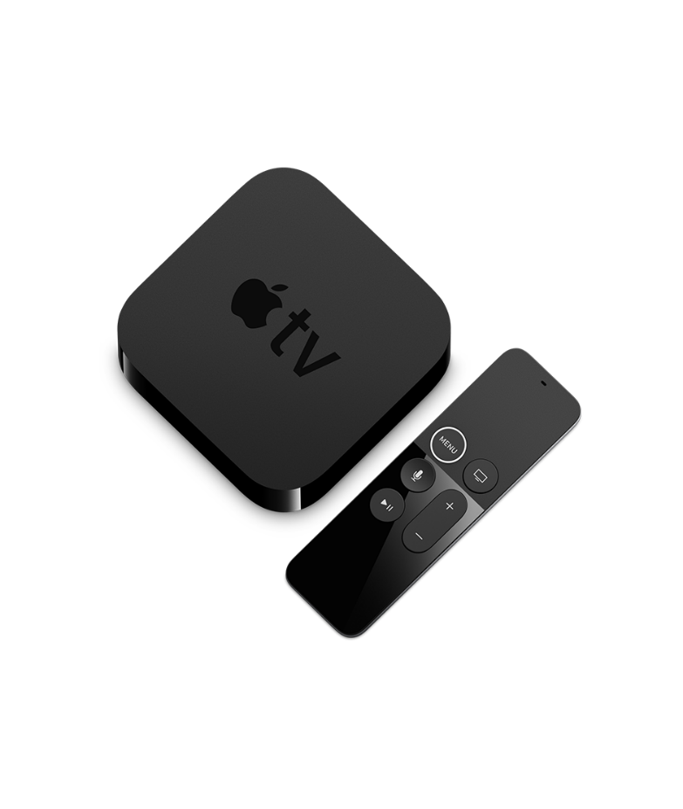
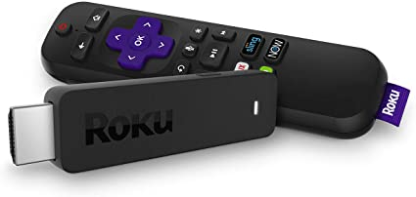
Hardware Devices
Smart TVs-built in connection
Roku ($29-$99)
Amazon Fire Stick ($38-$114)
Apple TV ($150-$180)
Google Chromecast ($39-$69)
HD antenna ($15-$50)
  Access networks without internet
Equipment is a one time fee

Slide 6
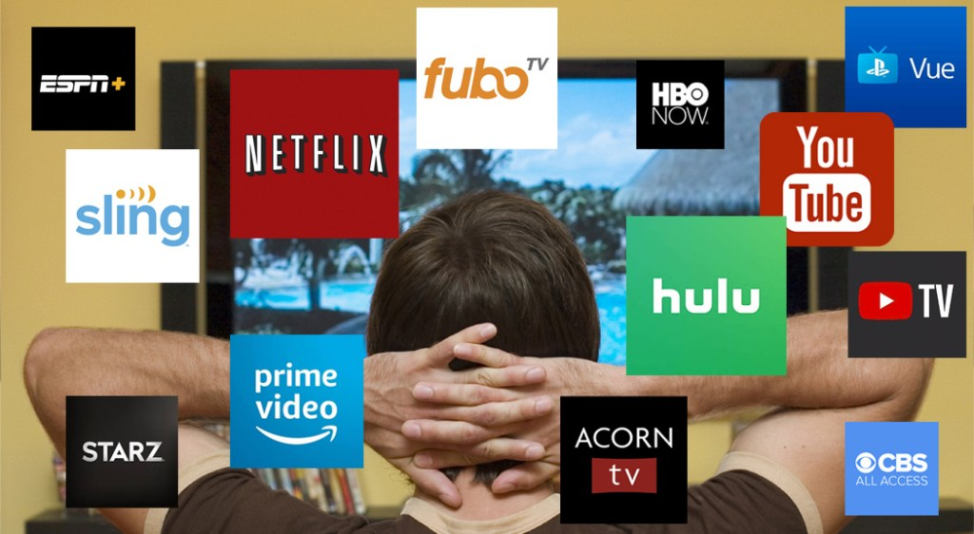
Programming
Live TV streaming services
  Similar to traditional TV
  Sling TV, YouTube TV, AT+T TV Now
On demand streaming services
  Content is pre-recorded and available to watch at any time
  Netflix, Hulu, Amazon Prime Video, Disney Plus

Slide 7
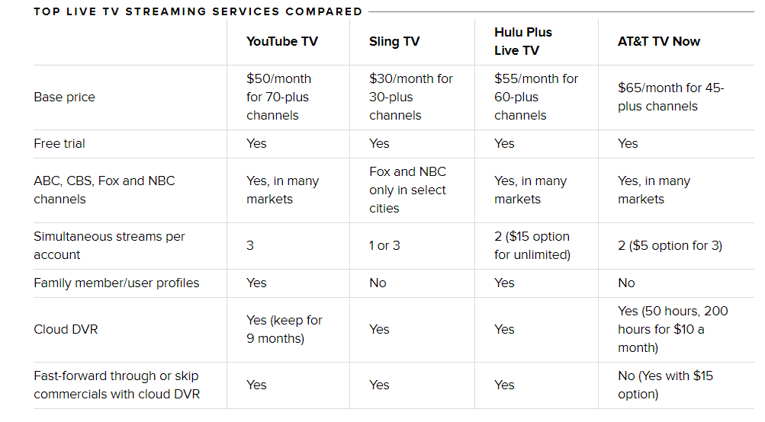
Comparison of Live Streaming Services
Source: CNET

Slide 8
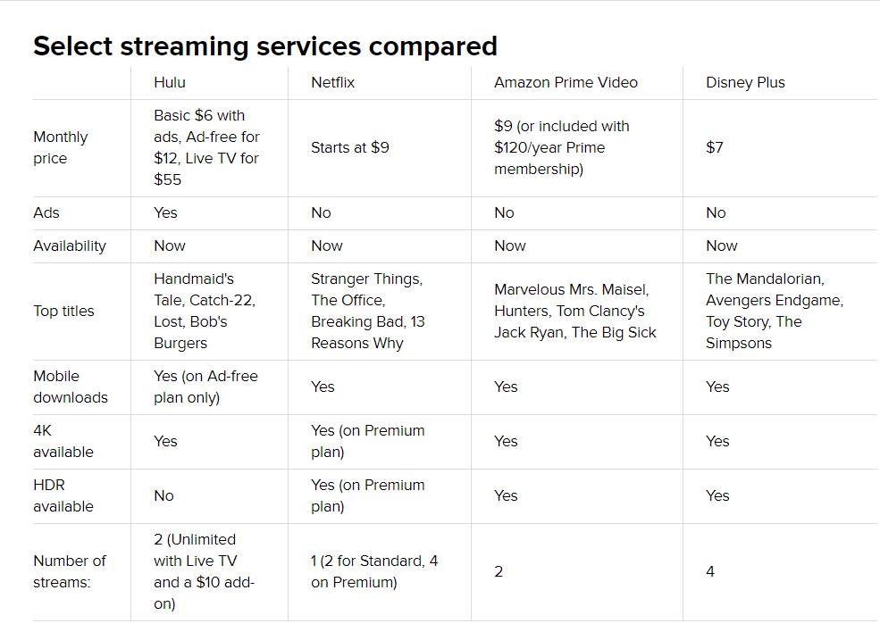
Comparison of On Demand Services
Source: CNET

Slide 9


Library Apps
5 titles per calendar month
72 hour loan period
Documentaries, Independent Productions, Foreign Films
10 titles per calendar month
72 hour loan period
Selection of movies and TV shows

Slide 10
Additional Resources
Consumer Reports www.balibrary.org/databases
Questions?
Email digitalservices@balibrary.org

