Slide 1
Getting Started with
Libby & Hoopla

Slide 2


Libby and OverDrive

Slide 3

Loan Rules
Libby
Hoopla
Both
E-books, Audiobooks, magazines
10 checkouts continuously
Magazines do not count against limit
Place up to 10 holds at a time
3 week loan period
Grab & Go collection loans are 7 days
Audiobooks, TV shows, movies
10 checkouts per calendar month
All items available immediately
3 week loan period for eAudiobooks
3 day loan period for TV & movies
Bingepass: Unlimited views for 7 days
Download content
(mobile devices)
Automatic returns

Slide 4
Libby: Features
  Manage Multiple Cards
  Great for families and shared
  devices.
  Return Early
  Free up shelf space or let the next
  person get a copy early.
  Suspend hold
  Read later and don’t lose your
  place at the top of the line!
  Renew
  Appears 3 days before loan is due
  if there are no holds.

Slide 5
Hoopla: Features
  Always Available
  There are no holds! If we
  have it, it’s yours!
  Bingepass
  Unlimited videos for 7 days
  The Great Courses or Curiosity
  Stream
  Bonus Borrows
  Watch or listen without using
  any of your monthly checkouts
  Watch on Streaming Devices
  Watch or listen from a host of
  Streaming devices including Roku
  and Apple TV

Slide 6
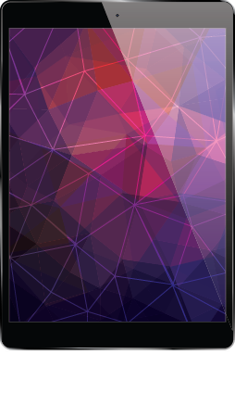
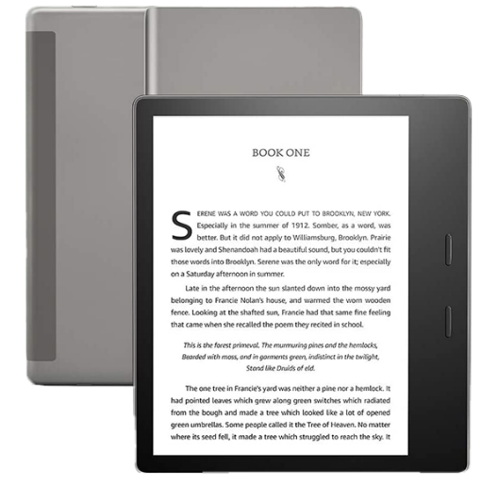
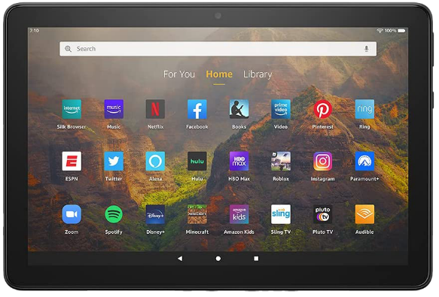
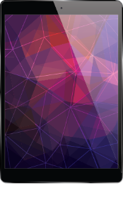
Libby: Devices
Tablets and Phones
Kindle Fire
E-readers

Slide 7
Tablets & Phones
Libby
Hoopla
Download the app and sign up or sign in
Search for a title
Click Borrow and the title will automatically start to download.
Press Open Book, chose Libby and enjoy!
Download the app and sign up or sign in
Search for a title to listen to or watch
Press ‘Download to your device’ or ‘Play.’

Slide 8
Kindle Fire
Libby
Hoopla
Start with a web-browser on the device or on another computer
Find a title you would like to borrow
Press borrow, go to shelf, Press ‘read with,’
and choose Kindle Book
Download the app and sign up or sign in
Search for a title to listen to or watch
Press ‘Download to your device’ or ‘Play.’

Slide 9
Computer
Libby
Hoopla
Go to libbyapp.com/library/balibrary
Find a title you would like to borrow
Press borrow, Open Book, and choose Libby
Use a computer to find a book or video on the Library’s Hoopla website.
Click borrow, then click Play and stream from your computer.

Slide 10

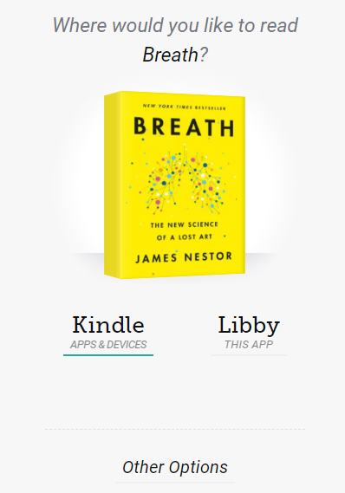
Kindle E-Ink Display
Paperwhite | Oasis
1. Use a computer to find a book on the Library’s Libby website.
2. Click borrow, go to shelf, click ‘read with’ and choose Kindle Book.
3. Sign in to your Amazon Account.
Select the correct device and
click ‘Get Library Book.’
Your book will the next time it is connected to WiFi.
automatically download to your Kindle reader

Slide 11
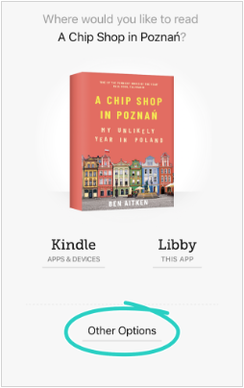
Other E-Ink Display
Glowlight | Kobo
1. Use a computer to find a book on the Library’s Libby website.
2. Click borrow, go to shelf, click ‘read with’ and choose Other options.
3. Select EPUB, then sign in to
your Adobe Digital Editions
Account and transfer with cable.

Slide 12
Hoopla: Roku & Apple TV
    Search for the app on Roku or Apple
    Add channel
    Sign-in
    Confirm your account by going to the verification link and entering the code

Slide 13
In App Features
Libby
Hoopla
Increase text size, including accessibility sizes
Change background for easier reading
Change font, including OpenDyslexic
Search within the book
Add bookmarks
Define words
Set playback speed
Set ‘sleep’ timer
Make comments
Adjust playback speed
Set sleep timer
Toggle time remaining in book or chapter
Add bookmarks
Picture in picture

Slide 14
Additional Resources
Contact Digital Services
digitalservices@balibrary.org
847-382-1300 x2050
Websites
https://balibrary.org/downloads
https://help.libbyapp.com/
https://www.hoopladigital.com/help

