Slide 1
balibrary.org

Slide 2
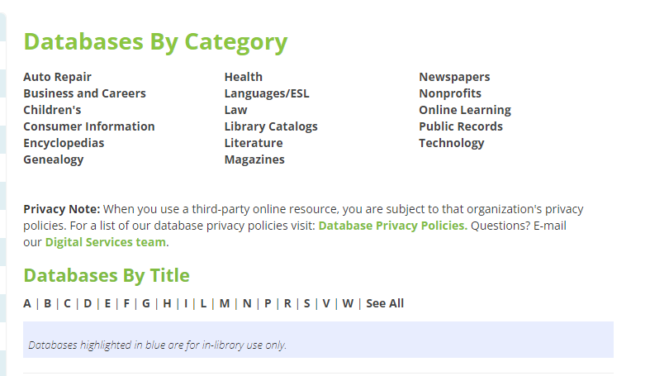
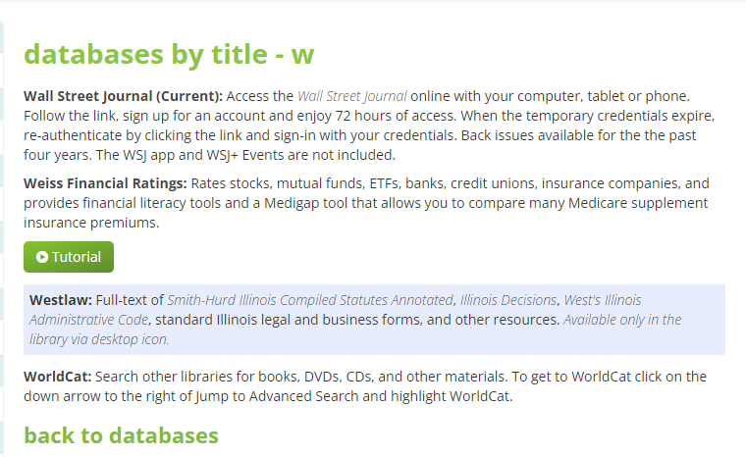
Click on W to get to Weiss Financial Ratings
Choose Weiss Financial Ratings Here

Slide 3
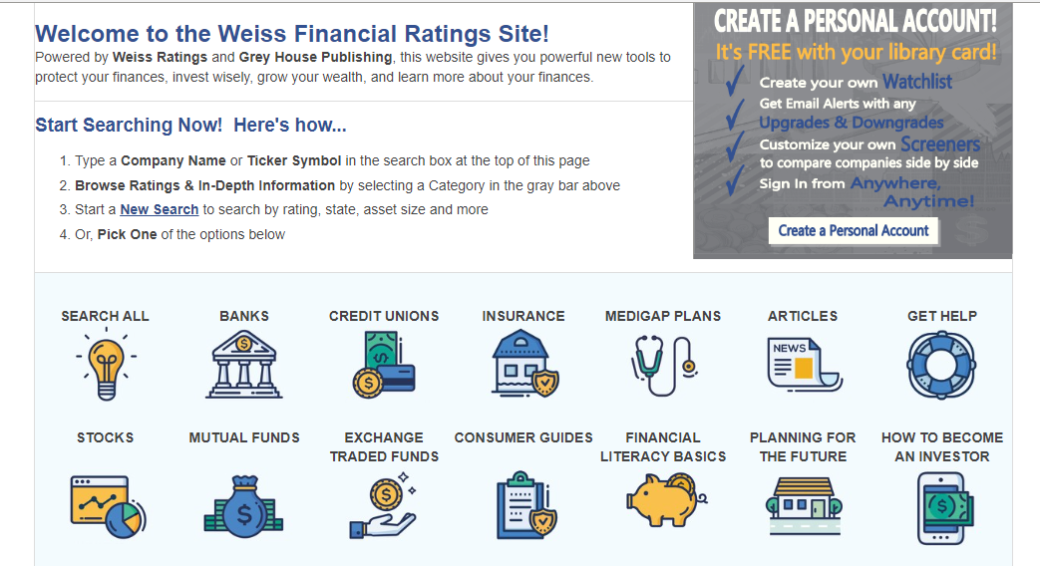
Click on Medigap Plans

Slide 4
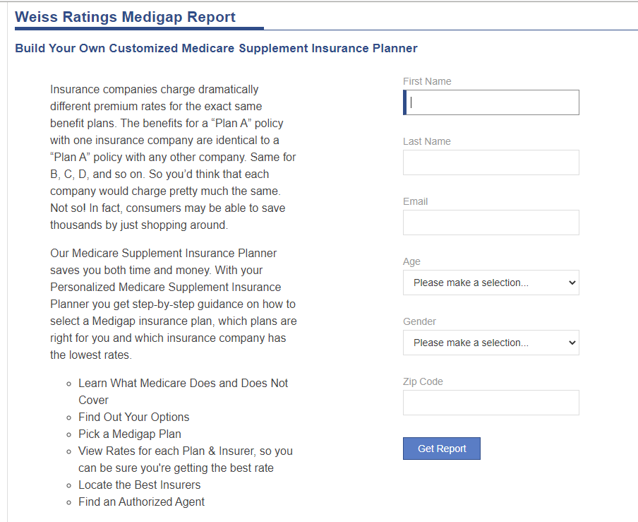
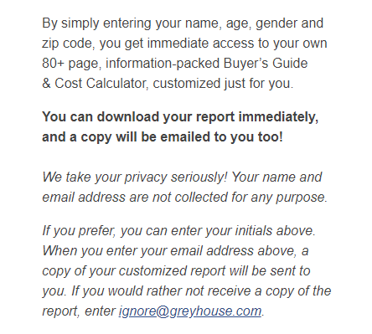
You can still download the report to your computer if you wish.

Slide 5
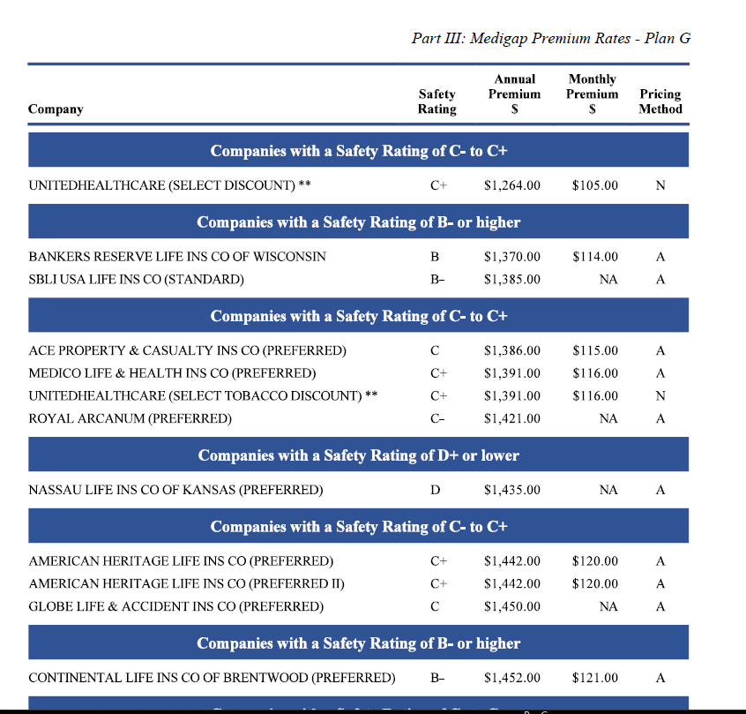

Slide 6
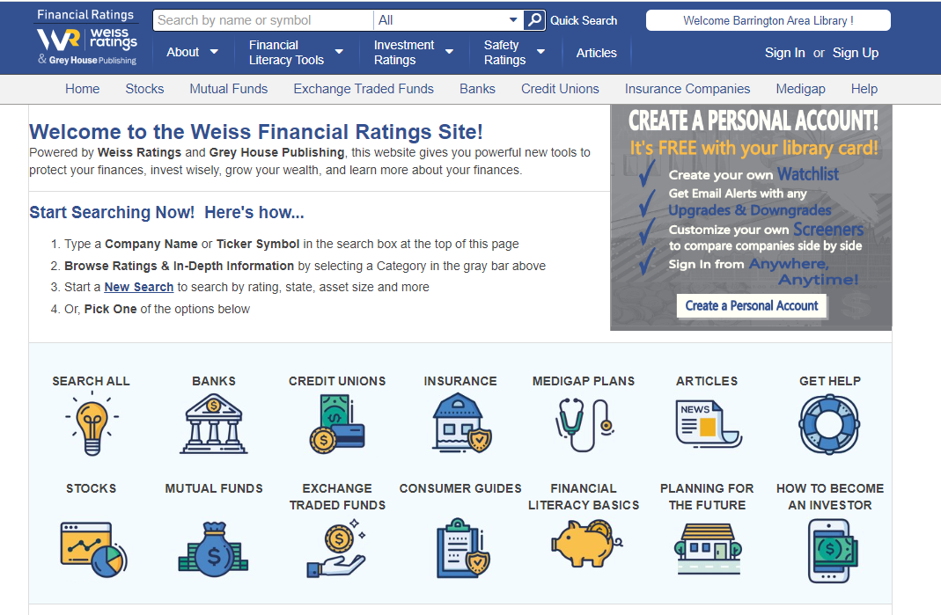
For More Information on an Insurance Company Click Here

Slide 7
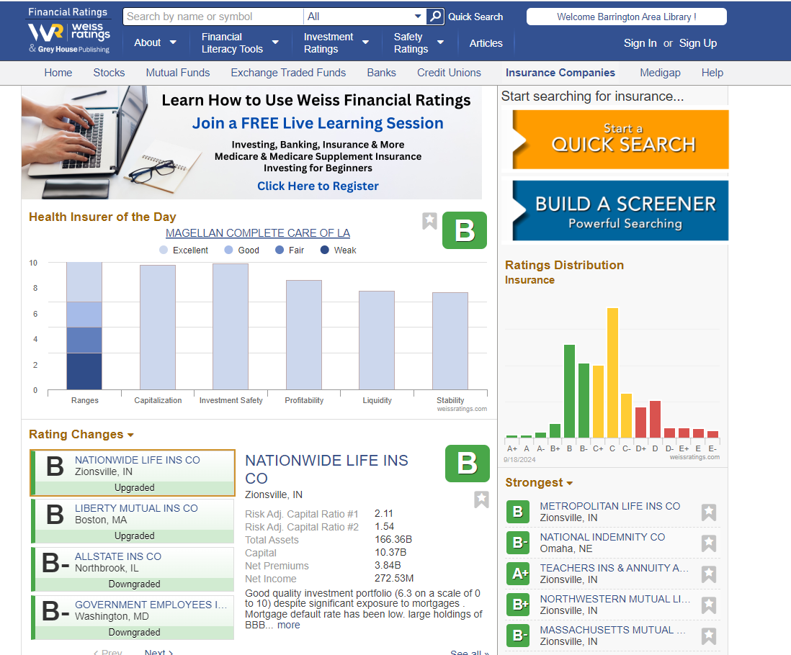
Type in the Name of the Company Here

Slide 8
